Slide 1

Understanding Fatal Police Shootings in the U.S.
2025
Zuleyka Benavides and Carlos Mata

Slide 2
Our analysis explores who is affected, how trends have changed over time, and the role of law enforcement.
OUR DATASET:
Timeframe: 2015 to 2024
Data Size: over 10,000 fatal incidents
Key Variables Analyzed:
🔫 Incident Details: Armed vs. unarmed, fleeing status, mental illness, body camera usage
👥 Demographics: Age, gender, race
📍 Location: City, state, law enforcement agency
📈 Trends Over Time: Changes in shooting rates

Slide 3

01
Incident Details

Slide 4
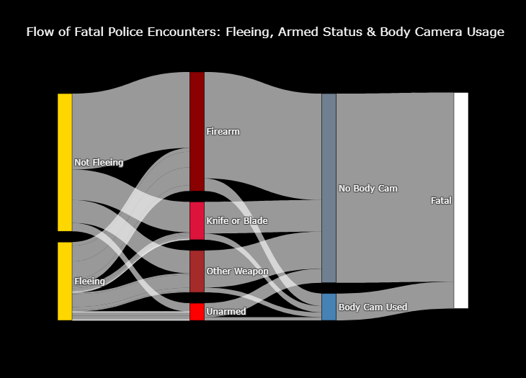
Flow of Fatal Police Encounters

Slide 5
11.23% of fleeing suspects were unarmed yet still faced a fatal encounter
4.07% of all fatal encounters involved a suspect who was fleeing and unarmed.

Slide 6
7.97% of all fatal encounters involved an unarmed individual, regardless of fleeing status.

Slide 7
87.56% of all fatal encounters happened without body camera footage.
Might indicate a potential gap in accountability.

Slide 8
65.02% of armed individuals were not fleeing.
This suggests confrontations escalated before movement occurred.

Slide 9
Weapon Type & Threat Posed
Threat types:
👉 "Point" → Suspect was perceived to be pointing a weapon (firearm, knife, or object) at officers or others.
〰"Move" → Suspect made sudden or aggressive movements, interpreted as an attempt to attack or resist.
😠"Verbal Threat" → The suspect made threatening statements that led officers to perceive imminent danger.
💀"Accident" → The encounter was classified as an unintentional incident, such as a misfire or mistaken identity.

Slide 10
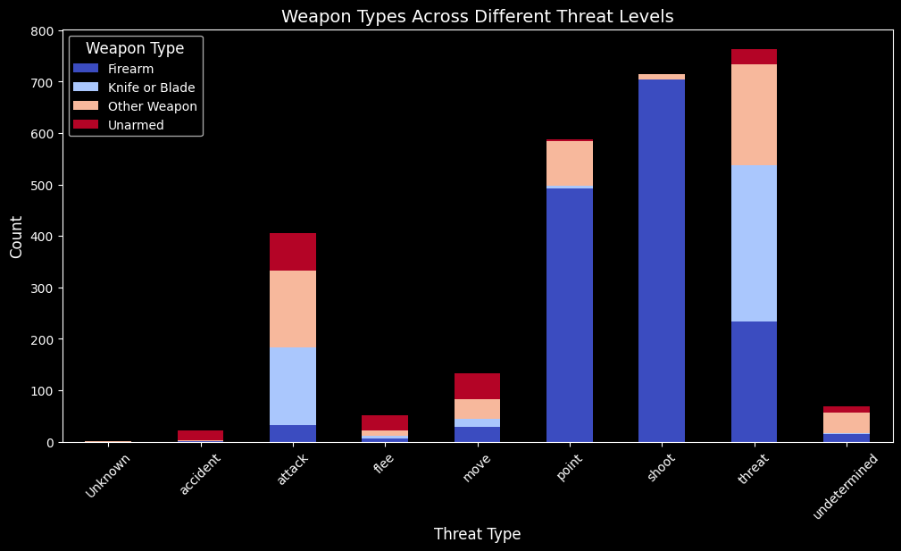
Firearms are very common with “point” and “move” threat types.

Slide 11
Unarmed individuals in high-threat categories, showing that perceived threat doesn’t always correlate with actual weapon possession.

Slide 12
Demographics
02

Slide 13
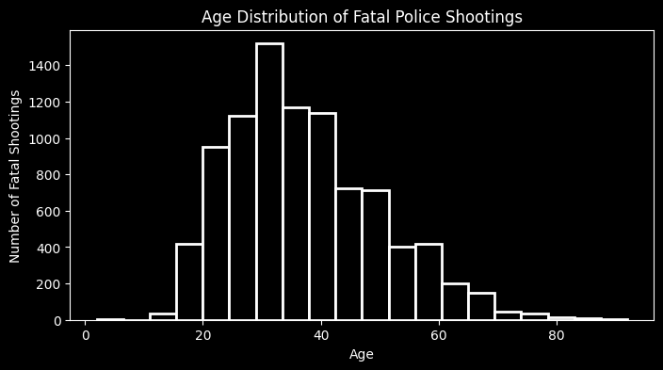
Most common ages involved range from late 20s to early 30s.

Slide 14
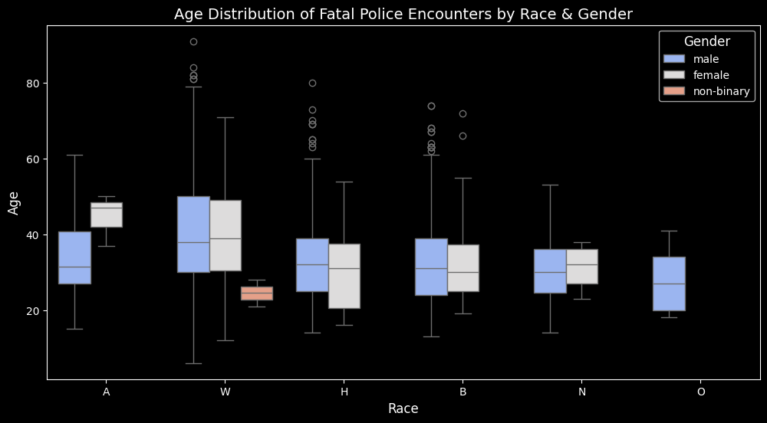
47
39
38
31.5
32
31
31
30
32
30

Slide 15
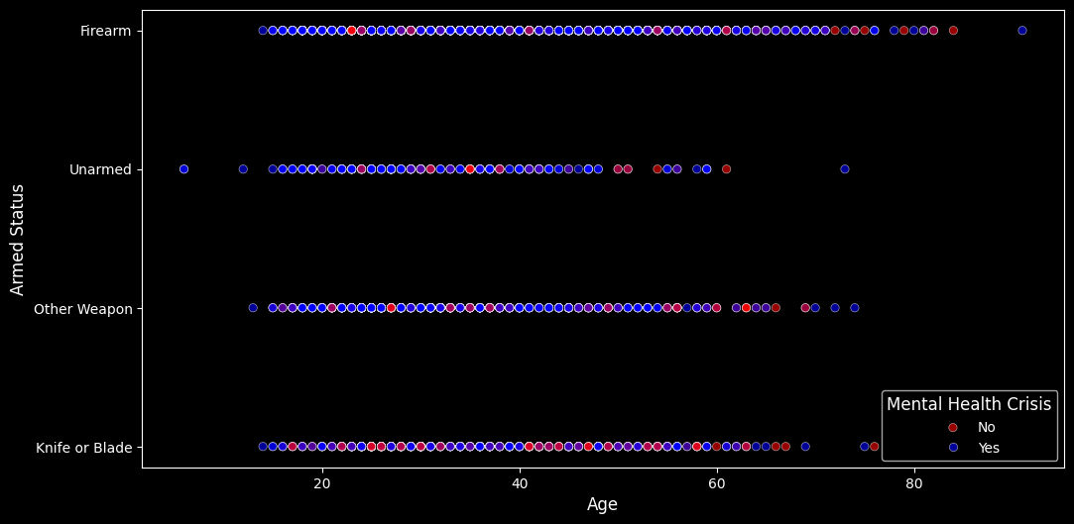
Younger victims are more likely to be unarmed or experiencing a mental health crisis.

Slide 16
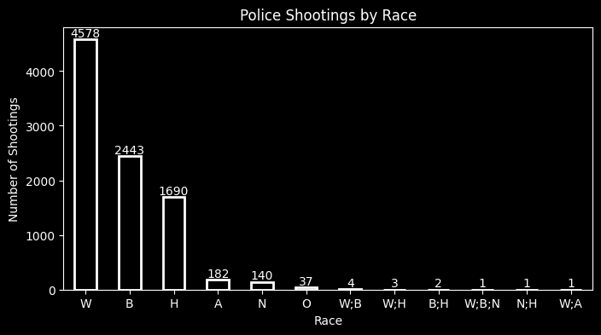
White (W) individuals represent the highest number of fatal police shootings.
Black (B) and Hispanic (H) individuals follow as the next most impacted groups.

Slide 17
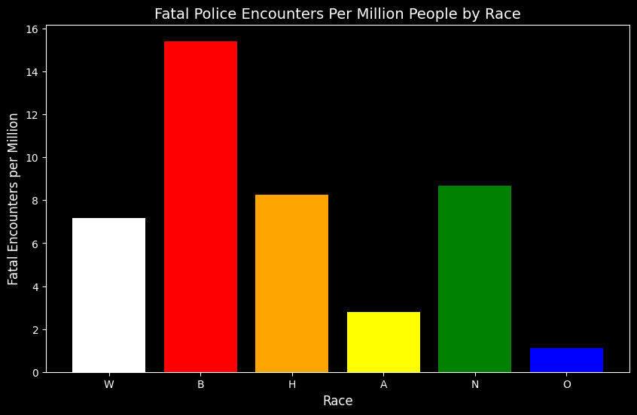
Per capita rate is significantly higher for Black individuals.

Slide 18
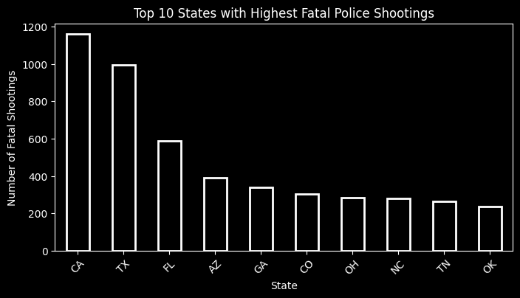
When adjusted for population size, states like New Mexico and Oklahoma show disproportionately high rates of fatal encounters.

Slide 19
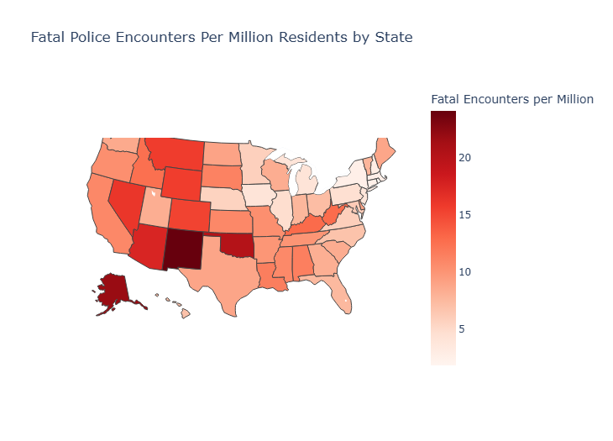

Slide 20
03
Law Enforcement Agencies

Slide 21
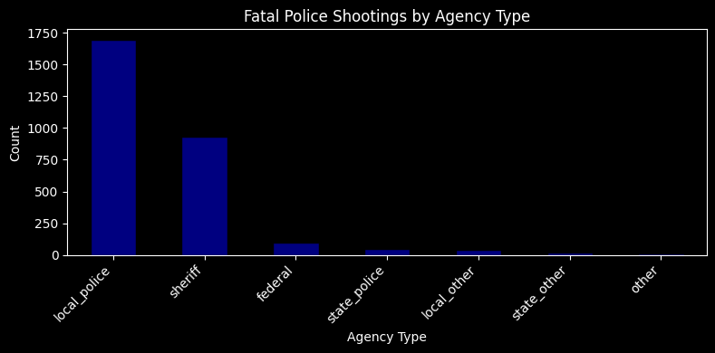

Slide 22
Local Police and Sheriff Agencies also have the greatest decrement in fatal shootings involvement.

Slide 23
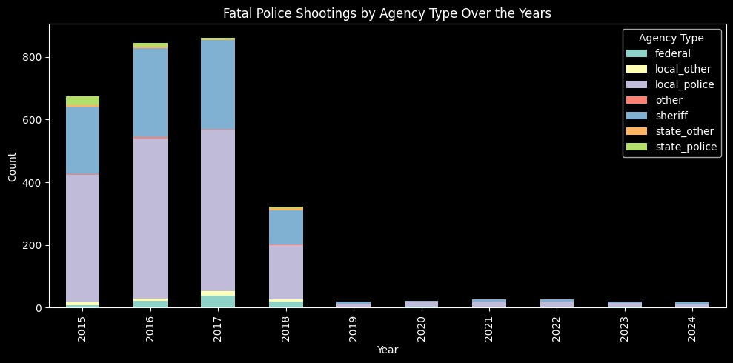

Slide 24
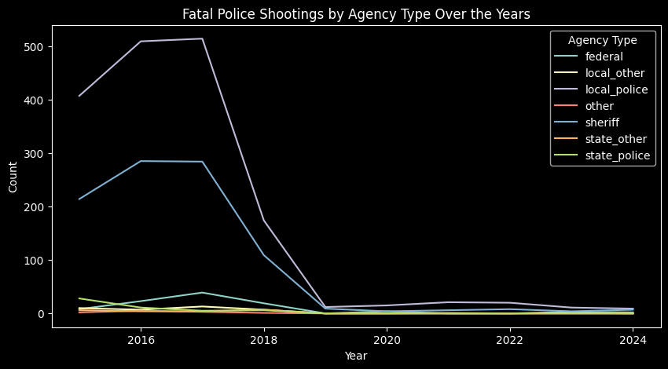

Slide 25
Local Police and Sheriff Agencies have by far the greatest involvement in fatal related shootings.

Slide 26
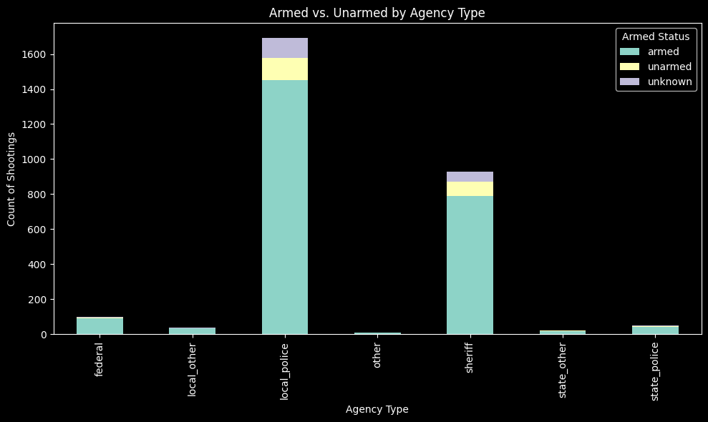

Slide 27
The majority of the shootings involved armed suspects across all agencies.

Slide 28
04
Correlations

Slide 29
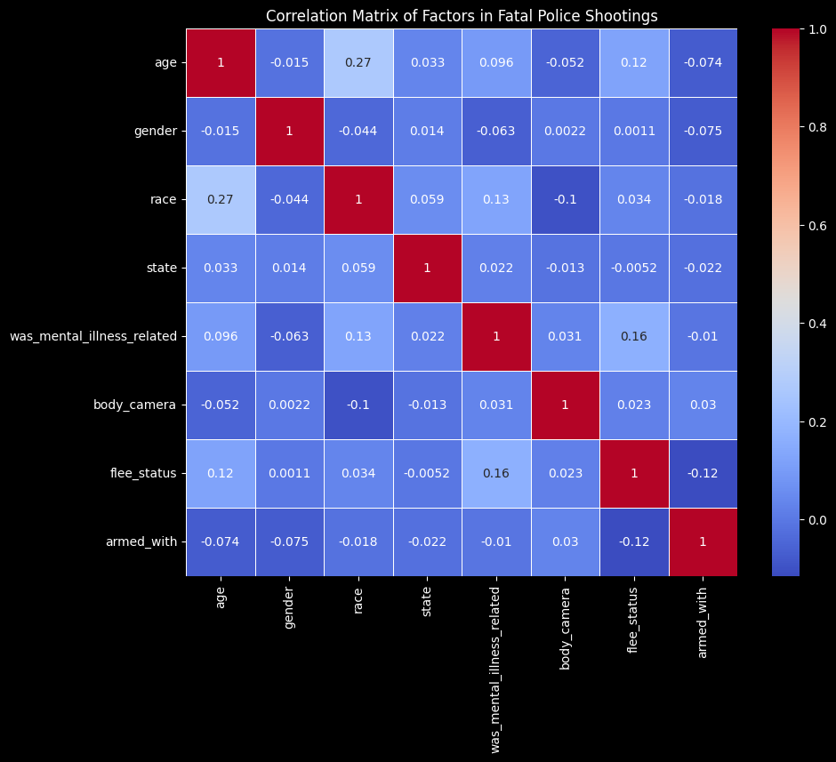
Race & Age: Different racial groups show different age distributions in shootings.
Mental Illness & Race: Mental illness involvement varies across racial groups.
Flee Status & Mental Illness: Individuals with mental illness are slightly more likely to flee.
Race & State: Different states have varying racial representations in shootings.

Slide 30
Key Findings
Incident Details
11.23% of fleeing suspects were unarmed yet still faced a fatal encounter.
87.56% of fatal encounters happened without body camera footage, highlighting a potential gap in accountability.
65.02% of armed individuals were not fleeing, suggesting that confrontations escalated before movement.

Slide 31
Key Findings
Demographics
Black individuals have a significantly higher per capita rate of fatal encounters compared to other racial groups.
13.09% of younger victims (<25) were unarmed, and 20.25% were experiencing a mental health crisis.
Most victims were male (over 95%).

Slide 32
Key Findings
Law Enforcement & Location
Local Police & Sheriff Departments were involved in the majority of fatal encounters.
When adjusted for population size, states like New Mexico and Oklahoma show disproportionately high fatal encounter rates.

Slide 33
Key Findings
Correlations & Trends
Mental illness involvement varies by race, with some groups more affected than others.
Individuals with mental illness were slightly more likely to flee during police encounters.
Different racial groups show different age distributions in shootings, with some trends being more pronounced in certain states.

Slide 34



Thanks!

